Slide 2

Financial Analysis & Modelling
Cost & Management Accounting - I
Best wishes
Dr R Narayanaswamy

Slide 3
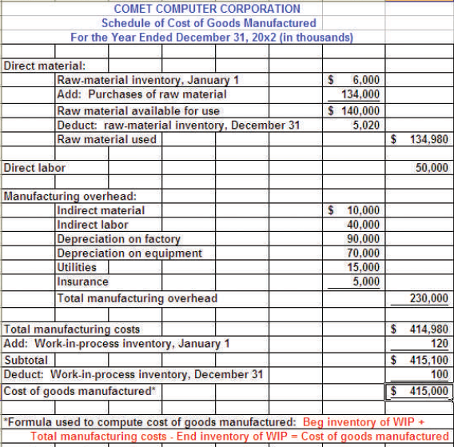
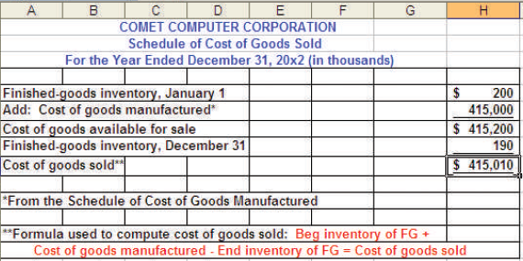
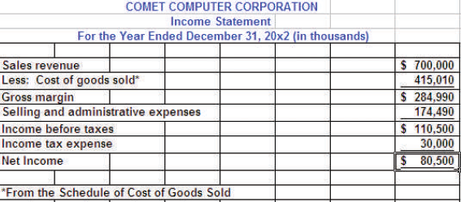
Cost Sheet – Integrating with Financial Accounting
+ 91 98452 87646 Dr R. Narayanaswamy r.narayanaswamy@spjain.org
Notes:
www.swamyspfa.in

Slide 4
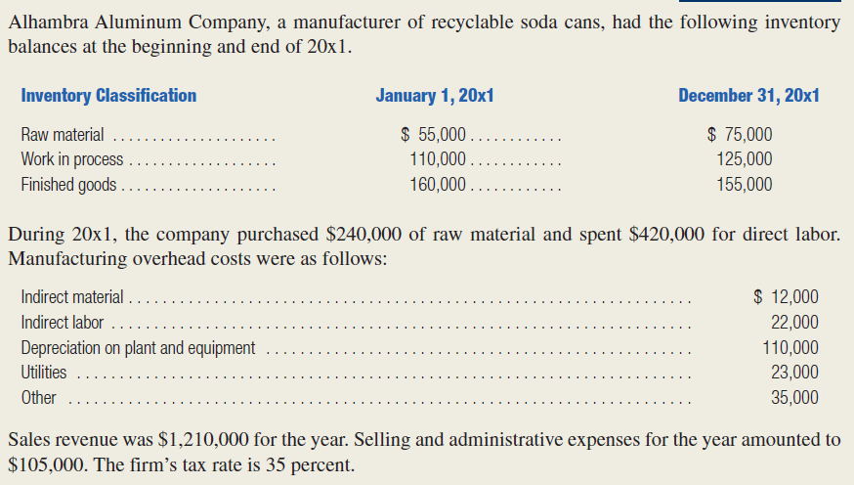
Prepare Cost sheet and Income Statement with sensitivity analysis
+ 91 98452 87646 Dr R. Narayanaswamy r.narayanaswamy@spjain.org
Notes:
www.swamyspfa.in

Slide 5
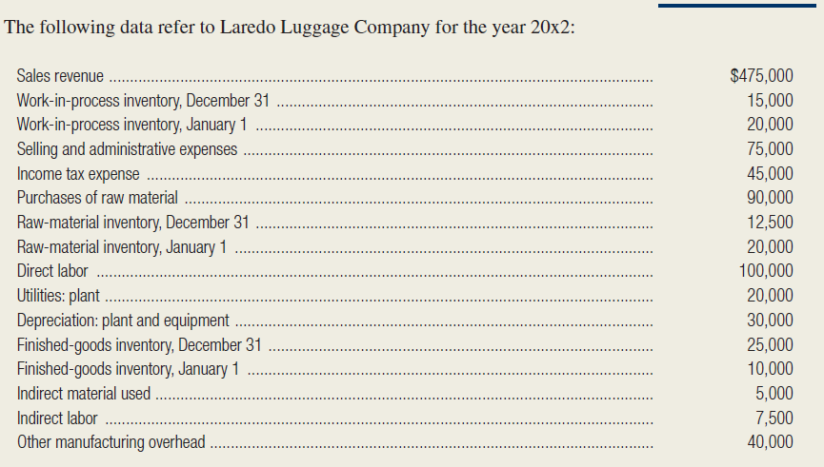
Prepare Cost sheet and Income Statement with sensitivity analysis
+ 91 98452 87646 Dr R. Narayanaswamy r.narayanaswamy@spjain.org
Notes:
www.swamyspfa.in

Slide 6
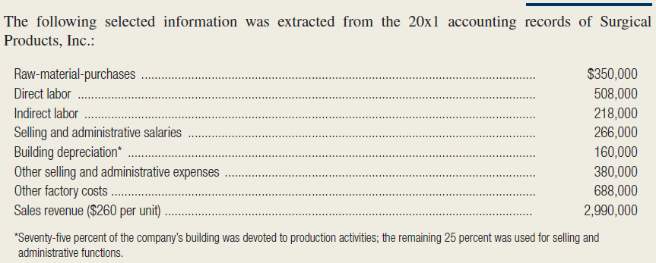
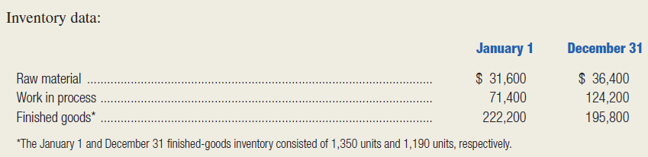
Prepare Cost sheet and Income Statement with sensitivity analysis
+ 91 98452 87646 Dr R. Narayanaswamy r.narayanaswamy@spjain.org
Notes:
www.swamyspfa.in

Slide 7
Job Costing
Used for production of large, unique, high-cost items.
Built to order rather than mass produced.
Many costs can be directly traced to each job.
Two types:
Job-shop operations - Products manufactured in very low volumes or one at a time
Batch-production operations - Multiple products in batches of relatively small quantity
Typical job-order cost applications: Special-order printing, Building construction
Also used in the service industry – Hospitals, Law firms
3-7
+ 91 98452 87646 Dr R. Narayanaswamy r.narayanaswamy@spjain.org
Notes:
Job-order costing is used by companies with job-shop operations or batch-production operations. In a job-shop environment, products are manufactured in very low volumes or one at a time. In job-order costing, each distinct batch of production is called a job or job order. The cost-accounting procedures are designed to assign costs to each job. Then the total costs assigned to each job are divided by the units of production in the job to obtain an average cost per unit.
In a batch-production environment, multiple products are produced in batches of relatively small quantity. Examples include furniture manufacture, printing, agricultural equipment, and pleasure boat production. (LO3)

Slide 8
Job costing in manufacturing industry – Lake outfitters
Lake Outfitters, a small manufacturer of canoes and small boats near Lake Placid, New York, uses job-order costing to accumulate the costs of each of its products. Job-order costing is well suited to companies like Lake Outfitters that manufacture relatively small numbers of distinct products.
In a job-order costing system, direct material, direct labor, and manufacturing overhead are first assigned to each production job, such as a set number of canoes of a particular type. Then the cost of the production job is averaged across the number of units in the job. These costs comprise the inputs of the product-costing system.
The company has received a job of producing 80 deluxe aluminum fishing boats (Job No. F16). Let us check up the job Costing for this case.
+ 91 98452 87646 Dr R. Narayanaswamy r.narayanaswamy@spjain.org
Notes:
www.swamyspfa.in

Slide 9
Job Costing
The primary document for tracking the costs associated with a given job is the
Job-cost record.
Let’s investigate
3-9
+ 91 98452 87646 Dr R. Narayanaswamy r.narayanaswamy@spjain.org
Notes:
In a job-order costing system, costs of direct material, direct labor, and manufacturing overhead are assigned to each production job. These costs comprise the inputs of the product-costing system. As costs are incurred, they are added to the Work-in-Process Inventory account in the ledger. To keep track of the manufacturing costs assigned to each job, a subsidiary ledger is maintained. The subsidiary ledger account assigned to each job is a document called a job-cost record. (LO3)
Let’s look at the Aluminum Fishing Boat Company (AFB).

Slide 10
Job Costing
+ 91 98452 87646 Dr R. Narayanaswamy r.narayanaswamy@spjain.org
Notes:
www.swamyspfa.in

Slide 11
Job Costing
A materials requisition form is used to authorize the use of materials on a job.
Let’s see one
3-11
+ 91 98452 87646 Dr R. Narayanaswamy r.narayanaswamy@spjain.org
Notes:
As raw materials are needed for the production process, they are transferred from the warehouse to the production department. To authorize the release of materials, the production department supervisor completes a material requisition form and presents it to the warehouse supervisor. (LO3)

Slide 12
Job Costing
Timothy Williams
+ 91 98452 87646 Dr R. Narayanaswamy r.narayanaswamy@spjain.org
Notes:
A copy of the material requisition form goes to the cost accounting department. (LO3)

Slide 13
Job Costing
+ 91 98452 87646 Dr R. Narayanaswamy r.narayanaswamy@spjain.org
Notes:
There it is used as the basis for transferring the cost of the requisitioned material from the Raw-Material Inventory account to the Work-in-Process Inventory account, and for entering the direct-material cost on the job-cost record for the production job in process. (LO3)

Slide 14
Job Costing
Accumulate direct labor costs by means of a work record, such as a time ticket, for each employee.
Let’s see one
3-14
+ 91 98452 87646 Dr R. Narayanaswamy r.narayanaswamy@spjain.org
Notes:
The assignment of direct-labor costs to jobs is based on time records filled out by employees. (LO3)

Slide 15
Employee Time Ticket
3-15
+ 91 98452 87646 Dr R. Narayanaswamy r.narayanaswamy@spjain.org
Notes:
A time record is a form that records the amount of time an employee spends on each production job. (LO3)

Slide 16
Job Costing
3-16
+ 91 98452 87646 Dr R. Narayanaswamy r.narayanaswamy@spjain.org
Notes:
The time record is the source document used in the cost accounting department as the basis for adding direct-labor costs to Work-in-Process Inventory and to the job-cost records for the various jobs in process. (LO3)

Slide 17
Job Costing
Apply manufacturing overhead to jobs using a predetermined overhead rate based on direct labor hours (DLH).
Let’s do it
3-17
+ 91 98452 87646 Dr R. Narayanaswamy r.narayanaswamy@spjain.org
Notes:
Manufacturing overhead is a pool of indirect production costs, such as indirect material, indirect labor, utility costs, and depreciation. These costs often bear no obvious relationship to individual jobs or units of product, but they must be incurred for production to take place. (LO3)

Slide 18
Manufacturing Overhead Costs
Overhead is applied to jobs using a predetermined overhead rate (POHR) based on estimates made at the beginning of the accounting period.
POHR =
Budgeted manufacturing overhead cost
Budgeted amount of cost driver (or activity base)
Overhead applied = POHR × Actual activity
Based on estimates, and determined before the period begins
Actual amount of the allocation base, such as direct labor hours, incurred during the period
Overhead applied = $30 per DLH × 600 DLH = $18,000
3-18
+ 91 98452 87646 Dr R. Narayanaswamy r.narayanaswamy@spjain.org
Notes:
The accounting department chooses some measure of productive activity to use as the basis for overhead application. In traditional product-costing systems, this measure is usually some volume-based cost driver (or activity base), such as direct-labor hours, direct-labor cost, or machine hours. An estimate is made of (1) the amount of manufacturing overhead that will be incurred during a specified period of time and (2) the amount of the cost driver (or activity base) that will be used or incurred during the same time period. (LO4)

Slide 19
Job Costing
3-19
+ 91 98452 87646 Dr R. Narayanaswamy r.narayanaswamy@spjain.org
Notes:
Therefore, it is necessary to assign manufacturing-overhead costs to jobs in order to have a complete picture of product costs. This process of assigning manufacturing-overhead costs to production jobs is called overhead application. A predetermined overhead rate is used to apply overhead on the job-cost record. (LO3)

Slide 20
Job Costing
3-20
+ 91 98452 87646 Dr R. Narayanaswamy r.narayanaswamy@spjain.org
Notes:
Once manufacturing overhead has been applied, the cost summary can be completed. Total direct material costs, total direct labor costs and total manufacturing overhead costs are added together to determine total costs. These costs are divided by the number of units completed to arrive at the unit cost. (LO3)

Slide 21
Job Costing
3-21
+ 91 98452 87646 Dr R. Narayanaswamy r.narayanaswamy@spjain.org
Notes:
The shipping summary is completed when the completed units are shipped to the customer. This summary shows units shipped, units remaining and the cost of the units remaining in inventory. (LO3)

Slide 22
Job-Order Costing - Document Flow Summary
Production Order for Job
The production order for the job authorizes the start of the production process.
The materials requisition indicates the cost of direct material to charge to jobs and the cost of indirect material to charge to overhead.
Material Requisition
Employee time tickets indicate the cost of direct labor to charge to jobs and the cost of indirect labor to charge to overhead.
Labor Time Records
Apply Manufacturing Overhead
Actual Cost Driver (or Activity Base)
X
Predetermined Overhead Rate
3-22
+ 91 98452 87646 Dr R. Narayanaswamy r.narayanaswamy@spjain.org
Notes:
The production order for the job authorizes the start of the production process. The materials requisition form identifies the amount of direct material to add to the job-cost records and the amount of indirect materials to add to the manufacturing overhead account.
The employee time tickets identity the amount of direct labor to add to the job-cost records and the amount of indirect labor to add to the manufacturing overhead account.
Overhead is applied to the job-cost records using some cost driver or activity base and a predetermined overhead rate. (LO5)

Slide 23
Schedule of Cost of Goods Manufactured
It is overhead applied
and not overhead
actually incurred
+ 91 98452 87646 Dr R. Narayanaswamy r.narayanaswamy@spjain.org
Notes:
The schedule of cost of goods manufactured details the costs of direct material, direct labor, and manufacturing overhead applied to work in process during the period and shows the change in Work-in-Process Inventory. The cost of goods manufactured is shown in the last line of the schedule. This is the amount transferred from Work-in-Process Inventory to Finished-Goods Inventory during the period. (LO6)

Slide 24
Schedule of Cost of Goods Sold
Actual overheads goes
to Income Statement
3-24
+ 91 98452 87646 Dr R. Narayanaswamy r.narayanaswamy@spjain.org
Notes:
This schedule shows the cost of goods sold for the period and details the changes in Finished-Goods Inventory during the month. The adjusted cost of goods sold appears as an expense on the income statement. (LO6)

Slide 25
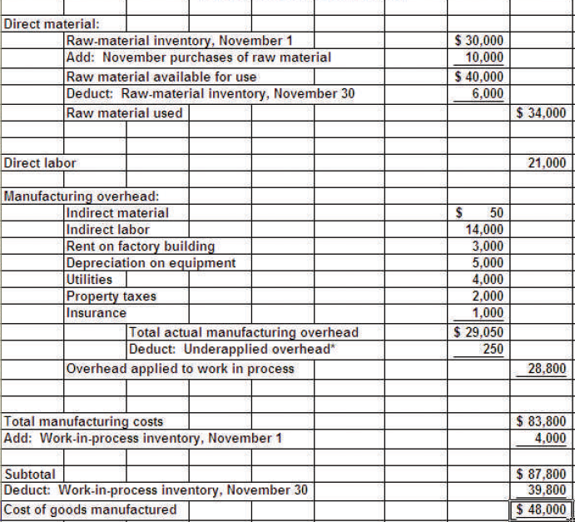
Let us see the schedules for Lake outfitters
Costs of Goods Manufactured
+ 91 98452 87646 Dr R. Narayanaswamy r.narayanaswamy@spjain.org
Notes:
Costs of Goods Manufactured

Slide 26
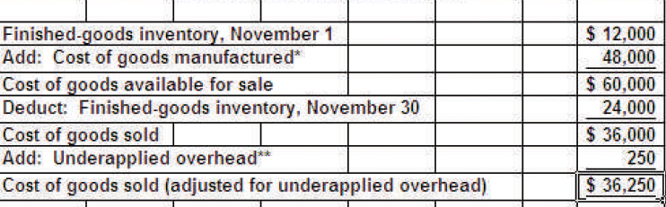
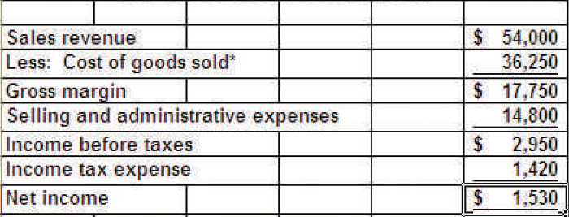
Let us see the schedules for Lake outfitters
Costs of Goods Sold
Income Statement
+ 91 98452 87646 Dr R. Narayanaswamy r.narayanaswamy@spjain.org
Notes:
www.swamyspfa.in

Slide 27
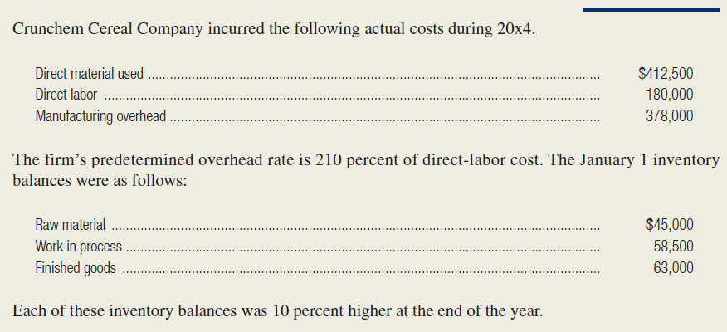
Prepare Cost sheet and Income Statement with sensitivity analysis
+ 91 98452 87646 Dr R. Narayanaswamy r.narayanaswamy@spjain.org
Notes:
www.swamyspfa.in

Slide 28

Happy Learning
Best wishes
+ 91 98452 87646 Dr R. Narayanaswamy lecswamy@gmail.com
Notes:
www.swamyspfa.blogspot.in

